Slide 1
High-Throughput Protein Production in Insect Cells
Sarah McBryan
Mentors: Andrea Throop and Justin Saul
April 18, 2015
24th Annual Arizona/NASA Undergraduate Research Symposium

Slide 2
Table of Contents:
Background of Proteins
Purpose
Method: Cloning
Results: Cloning
Method: Insect Cell Culture and Protein Expression
Results: Cell Culture
Future Project Ventures

Slide 3
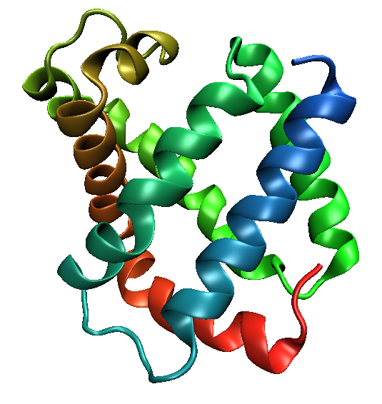
Proteins:
Proteins are machines that perform nearly all biological molecular functions
The human proteome is all the proteins in the human body
Approximately 75% of the proteome lacks good characterization¹
15% has been barely studied at all²
Protein Data Bank. http://www.rcsb.org/pdb/home/home.do
Kim et al. A draft map of the human proteome. Nature. 509, 575–581. 29 May 2014
PDB ID 1MBA;
Nature: A draft map of the human proteome
Notes:
Human genome project classified by function

Slide 4
Need:
To adequately address any proteome, large quantities of many different proteins are needed.
Large scale studies require adequate numbers of proteins
A pipeline, or assembly/factory line, is needed provide samples for researcher projects
Our goal is to create an efficient and automated pipeline for producing protein in insect cells, i.e. provide a localized pipeline for researchers.

Slide 5
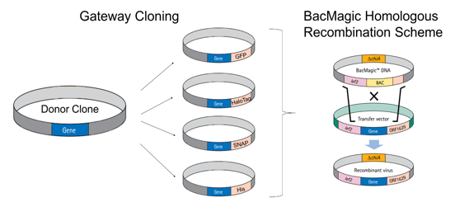
Methods: Cloning
Modify transfer vector DNA with fusion tags and allow high-throughput detection and purification of large numbers of proteins
Lars, Redecke., et al. Science. Dec 2012

Slide 6
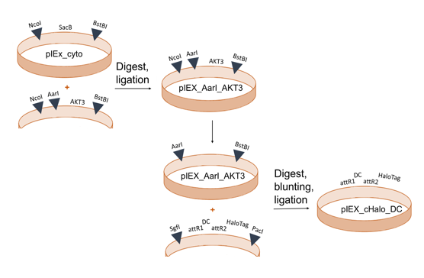
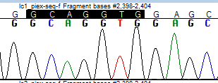
Results: Cloning
After 3 rounds of cloning, we have completed our first gateway compatible transfer vectors with a C-terminal HaloTag Fusion.
We’re developing more transfer vectors with different fusion tags
Notes:
Fusion tags and primers have been successfully added to the vector

Slide 7
Methods: Insect Cell Culture and Protein Expression
Grow, preserve, transfect, and lyse insect cells
Testing expression inside insect cells
We test the expression with polyacrylamide gel electrophoresis to characterize the protein we make
How big is it, how many, what is it made up of, etc.
Purification
Extract the protein from the insect cell via fusion tags
Optimize protocols to increase yield and purity
Notes:
Emphasize that this is brand new for our lab, how we had to find and even create new procedures, etc.

Slide 8
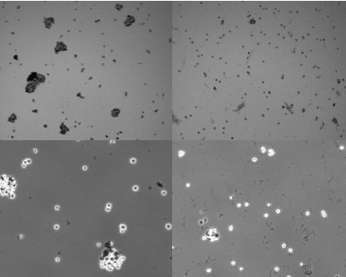
Results: Cell Culture
We are working to optimize the growth conditions for our insect cells.
Comparing shaker speed and orbit size
Thomson
250 rpm; 0.5” orbit
Innova 44
150 rpm; 1” orbit
28 hours shaking after resuspension
12.5 mL volume per flask
28°C

Slide 9
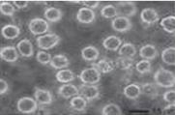
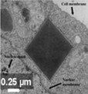
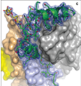
Future Project Ventures:
This is a multi-year project, starting with this initial research in cloning vectors/growing up micro crystals and continuing in a collaboration with Petra Fromme and John Spence.
Solve crystal structures determined from the micro crystals
In Vivo Protein Crystallization Opens New Routes in Structural Biology; Lars, Redecke. Science

Slide 10
Thank you to the LaBaer Laboratories at Biodesign, my mentors Andrea Throop and Justin Saul, my teammates David Haddad and Hannah Johnson, and the NASA Space Grant program for funding me.

